Slide 1
Jana Rakshan
Jana Rakshan

Slide 2
theme of the proposal
The main objective of the project is to provide the complete protection to the users from Covid—19.
In this proposal , we are focusing to elevate the awareness on social distancing , mask wearing ,self protection methods ,suggestions and tele medicine services.

Slide 3
The important functions of the android application is 1. Mask Verification 2.Providing e – Commerce Platform to buy best quality Covid products. 3.Sending social distancing violation alerts to user. 4.Suggesting the “SAFE PATH” to user. 5.Travelling Hisory 6.Accurate hospital information and possible to register bed
BRIEF DESCRIPTION

Slide 4
Mask Verification
When where the user came out from the house[By tracing the loaction] Our “APP” will send the notifications to the users till to wear the mask and after wearing the mask he need to show front camera for the verification .
After this , our “APP” will displays the “ACCETANCE” percentage to the user based on the position of the mask on the face. It helps the user to protect himself.
In this , we are also providing the link to buying the best quality “Covid-19” products to user.
By this feature , We suggest the quality to the users and chance for the marketing

Slide 5
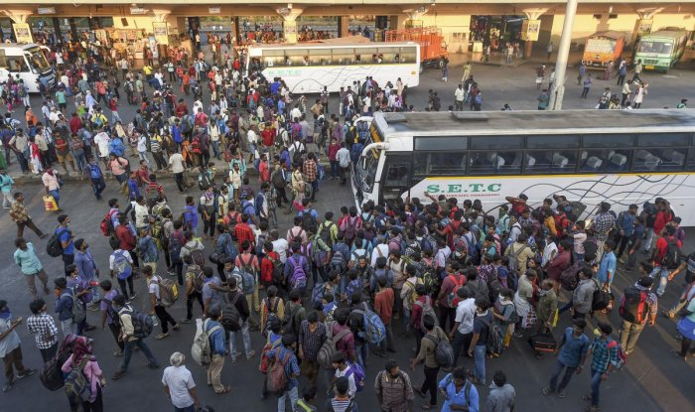
Social Distance Violation
Let’s us consider bus stand as example, we seen lot of people will gathered during stepping in &out from the bus.

Slide 6
At that time ,when people comes closer to each other and having a distance less than 2 meters[as per requirement]. Our “APP” will trace the signals and send the alert messages to the people[mobile owners]for twice .By this alert messages people will maintain some distance.
In case the people[mobile owner] will ignore this alert message for twice , by using his data we will insert a “penalty” as 500-/- rupees [according to effect of virus in that area] . If people[mobile owner] will ignore that message also a “police man” will approach the person and collect t he money.

Slide 7
Here the user have a chance to find the “SAFE ROUTE” through the “APP” by entering the source and destination details . Based on the given information, and number of “Covid” cases our “APP” will fetch the google maps and suggest the safe path to the user.
In this ,there is chance for the user to get “Travelling History”
We are also providing the information like how many number of covid patients we meet during his journey , by analysing ,how many number of covid patients he meet , we will predict the “Chance of Effect” on the user.
It helps user to understand his condition

Slide 8
Bed Registration & Health Analysis
This is the key feature of the “APP”, by verify the chance of effect on the user , based on the condition he can search the near hospital details along with bed availability.
If he required , he can register a bed in near
hospital .
It helps the user to avoid confusion and last minute rush while joining the hospital .

Slide 9
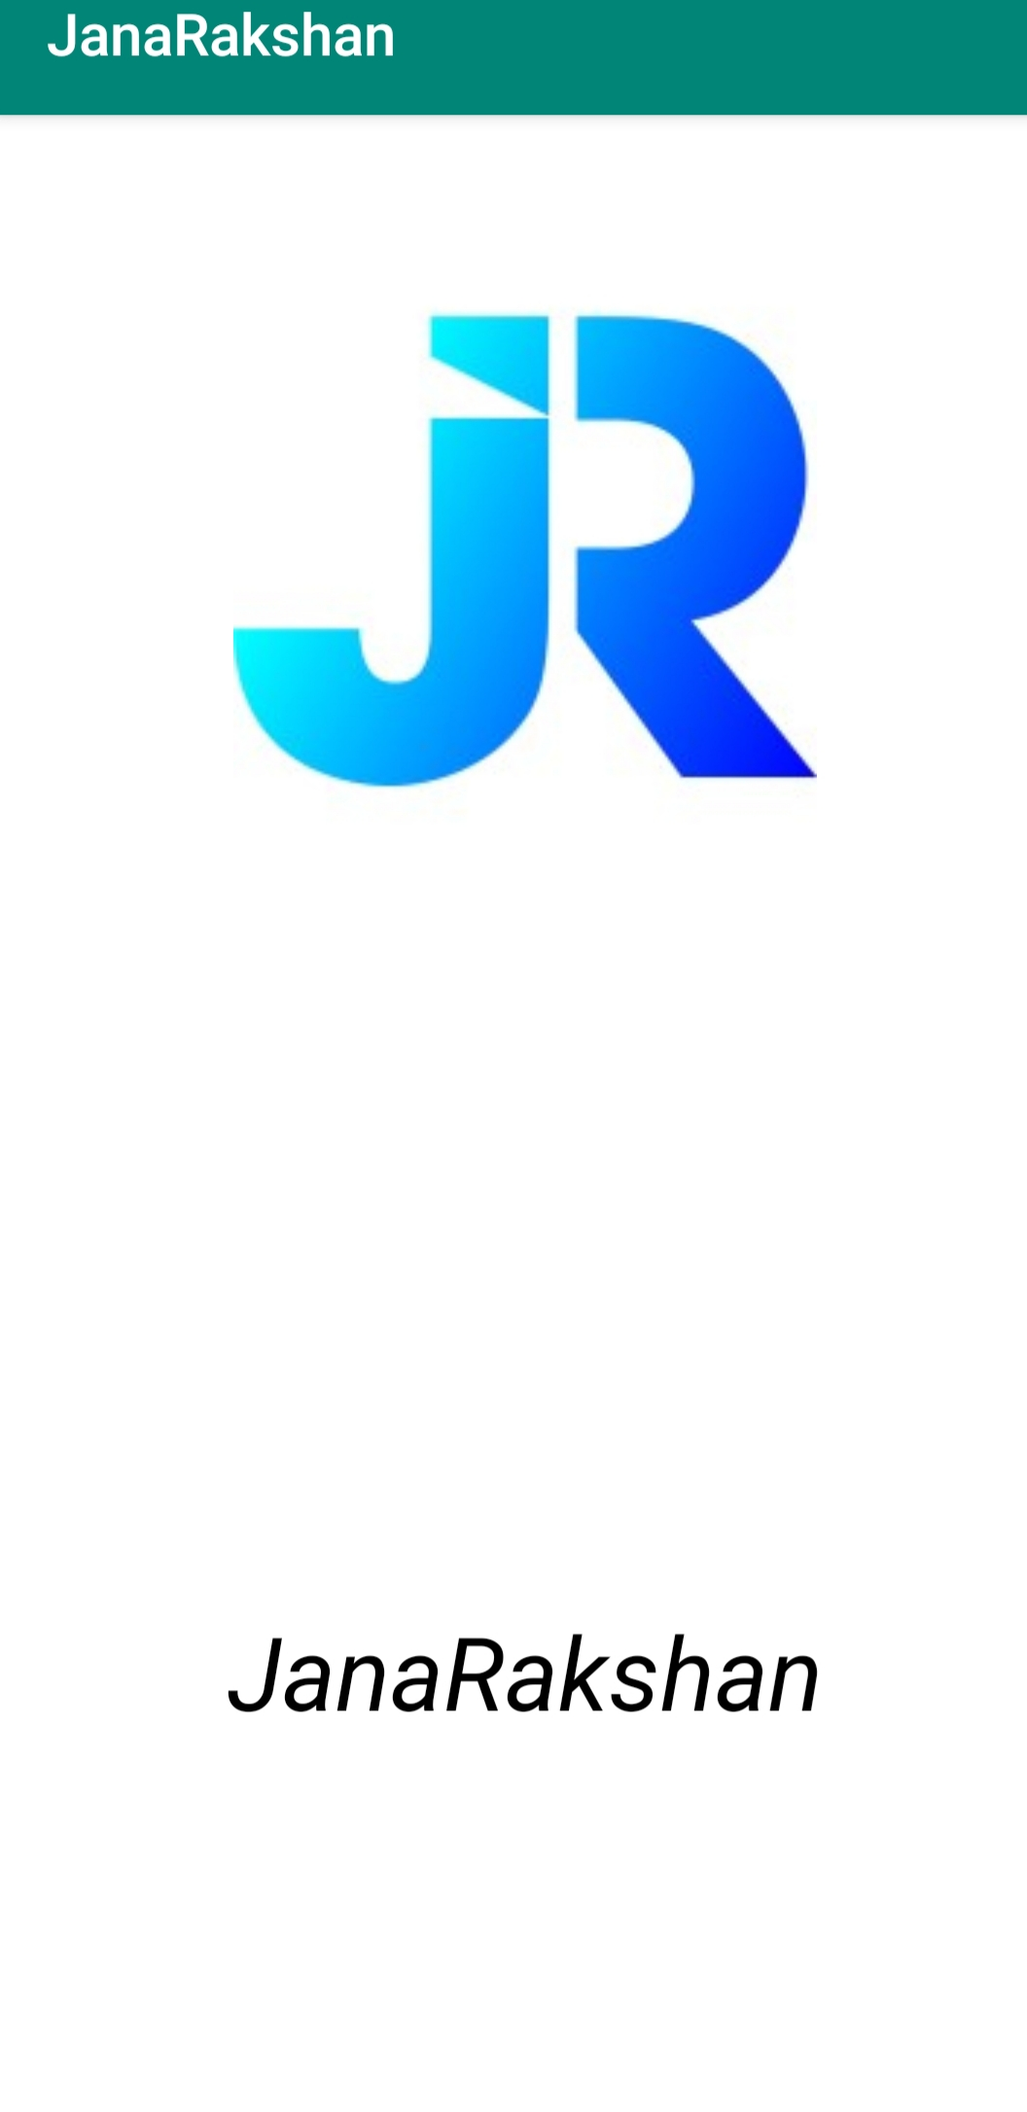
Process Flow: After installation of the APP this is the first page
Then it will re-direct to another page

Slide 10
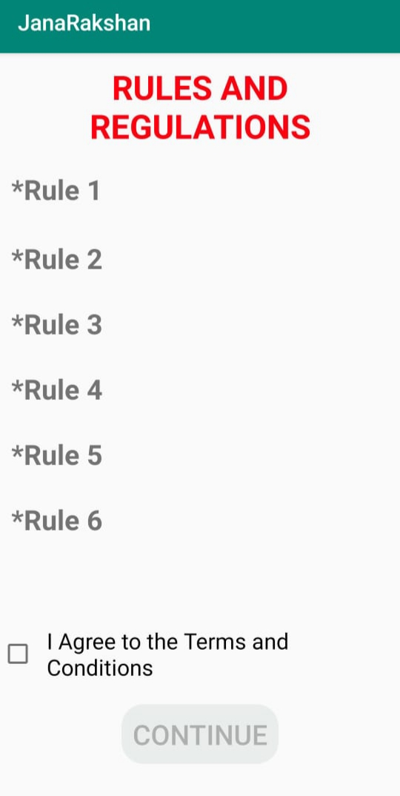
This is the second page it includes some rules and regulations
If you agree the rules and regulations ,click on the box
then it will redirect to third page

Slide 11
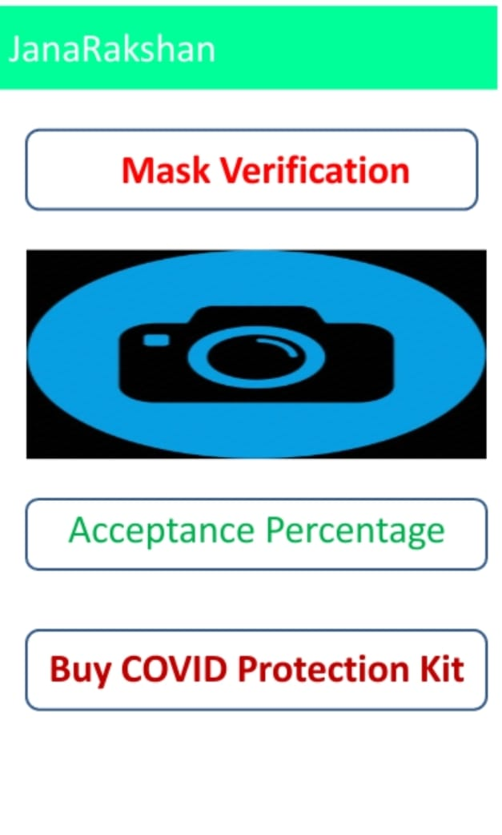
This is the “Mask Verification” Page along
Here some options are available for user , if he
can click on required option

Slide 12
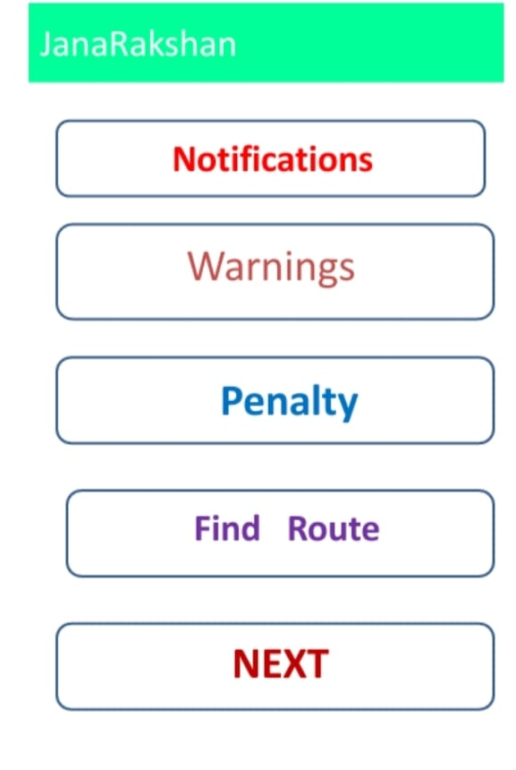
This is the notification page , according to user requirement he can click on the options
By click on the “Next” tab ,it will redirect to the next page

Slide 13
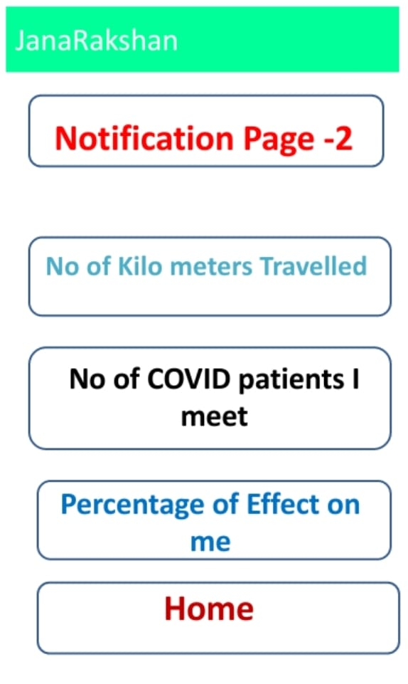
Here , some more features are providing to the users
By click on the “HOME” tab , it will redirect to homepage

Slide 14
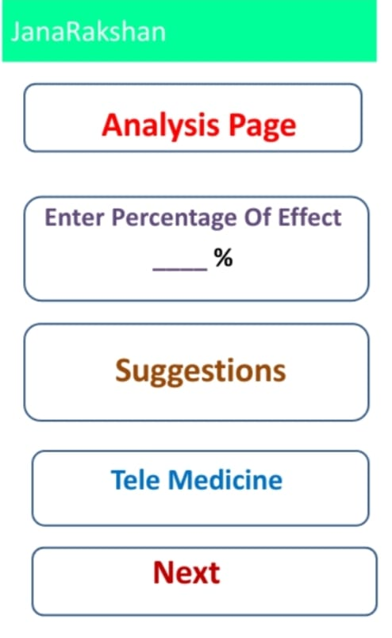
In this page we analyze the health condition of the user.
This page , we are providing “Tele-medicine” services

Slide 15
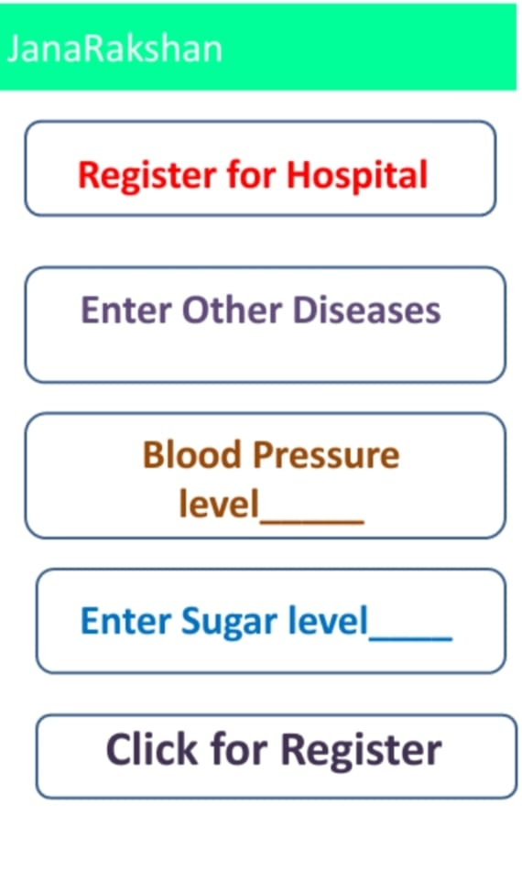
In this page , user need to enter some details for register a bed
Click here to register a bed

Slide 16
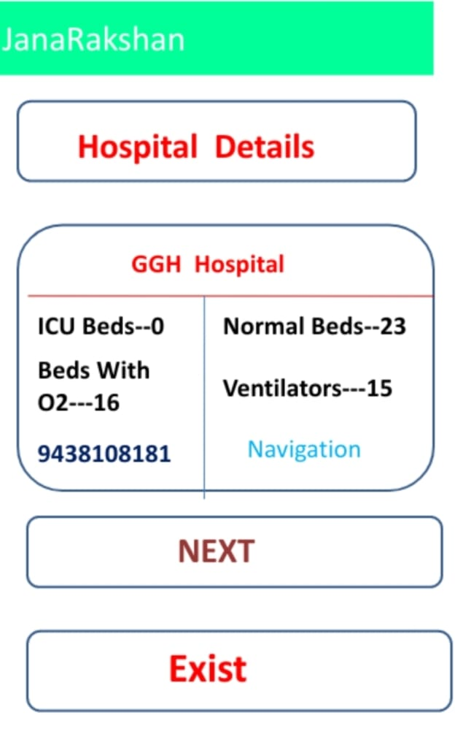
Here all the hospital details will be displayed here
By click on the hospital name to register a bed

Slide 17
Software Requirement
Android Studio
2.HTML
3.XML
We used the above programming languages to
Implementation of this application.
Actually , we are implemented only 50% of the
application due to time concern , we need some
more time to build this application .

Slide 18
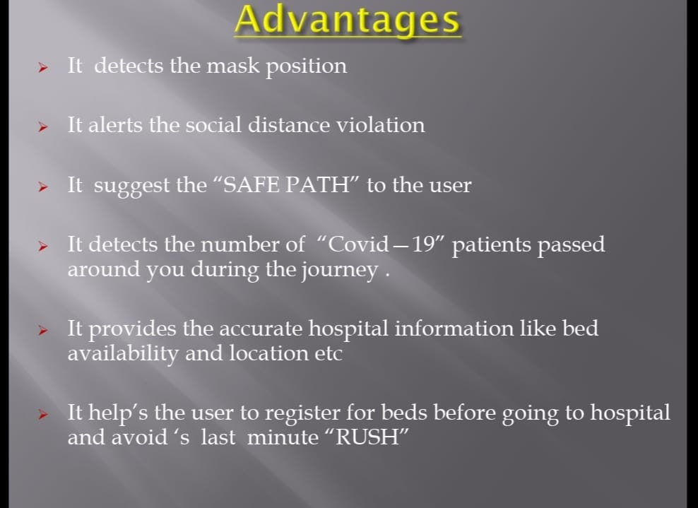

Slide 19
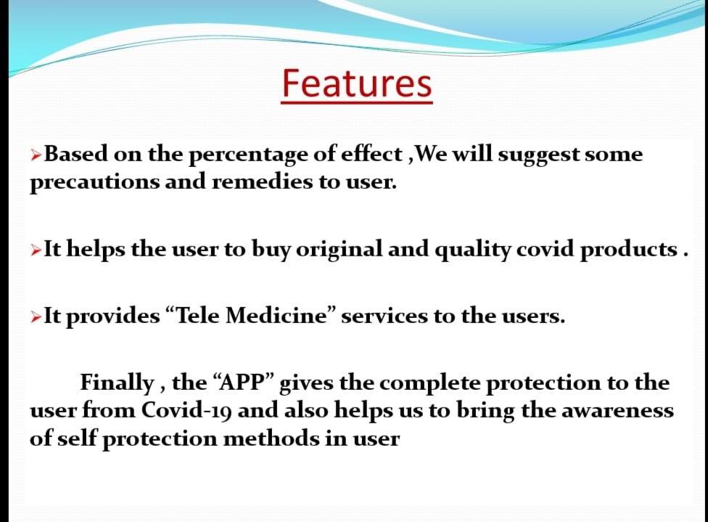

Slide 20


